Slide 1

Everything is Broken - COIVD 19, Learning from Failure, and the Importance of Reflexive Practice
Why Evaluate? Lunchtime Conference Programme: Widening Participation, Evaluation and COVID 19
Welcome to today’s session.
Please keep your microphones muted.
There will be a 20-30 minute presentation or panel discussion.
We will then have 25 minutes for questions and discussion.
We may record the presentation / panel discussion, but we will turn recording off for the open discussion.
Please contribute to the discussion or ask your questions via Zoom’s chat function (at the bottom of your screen). Please address your chat to everyone. The meeting host will read out your question / comment.
Chris Bayes
Julian Crockford
Gino Graziano
#whyevaluate
@VilliersPark
@JulianCrockford

Slide 2
Motivational Speeches?
‘But still, everything is broken.’
Radiohead – Planet Telex
‘When you try your best, but you don't succeed’
Coldplay – Fix You
‘Ever tried. Ever failed. No matter. Try again. Fail again. Fail better.’
Samuel Beckett – Worstward Ho

Slide 3
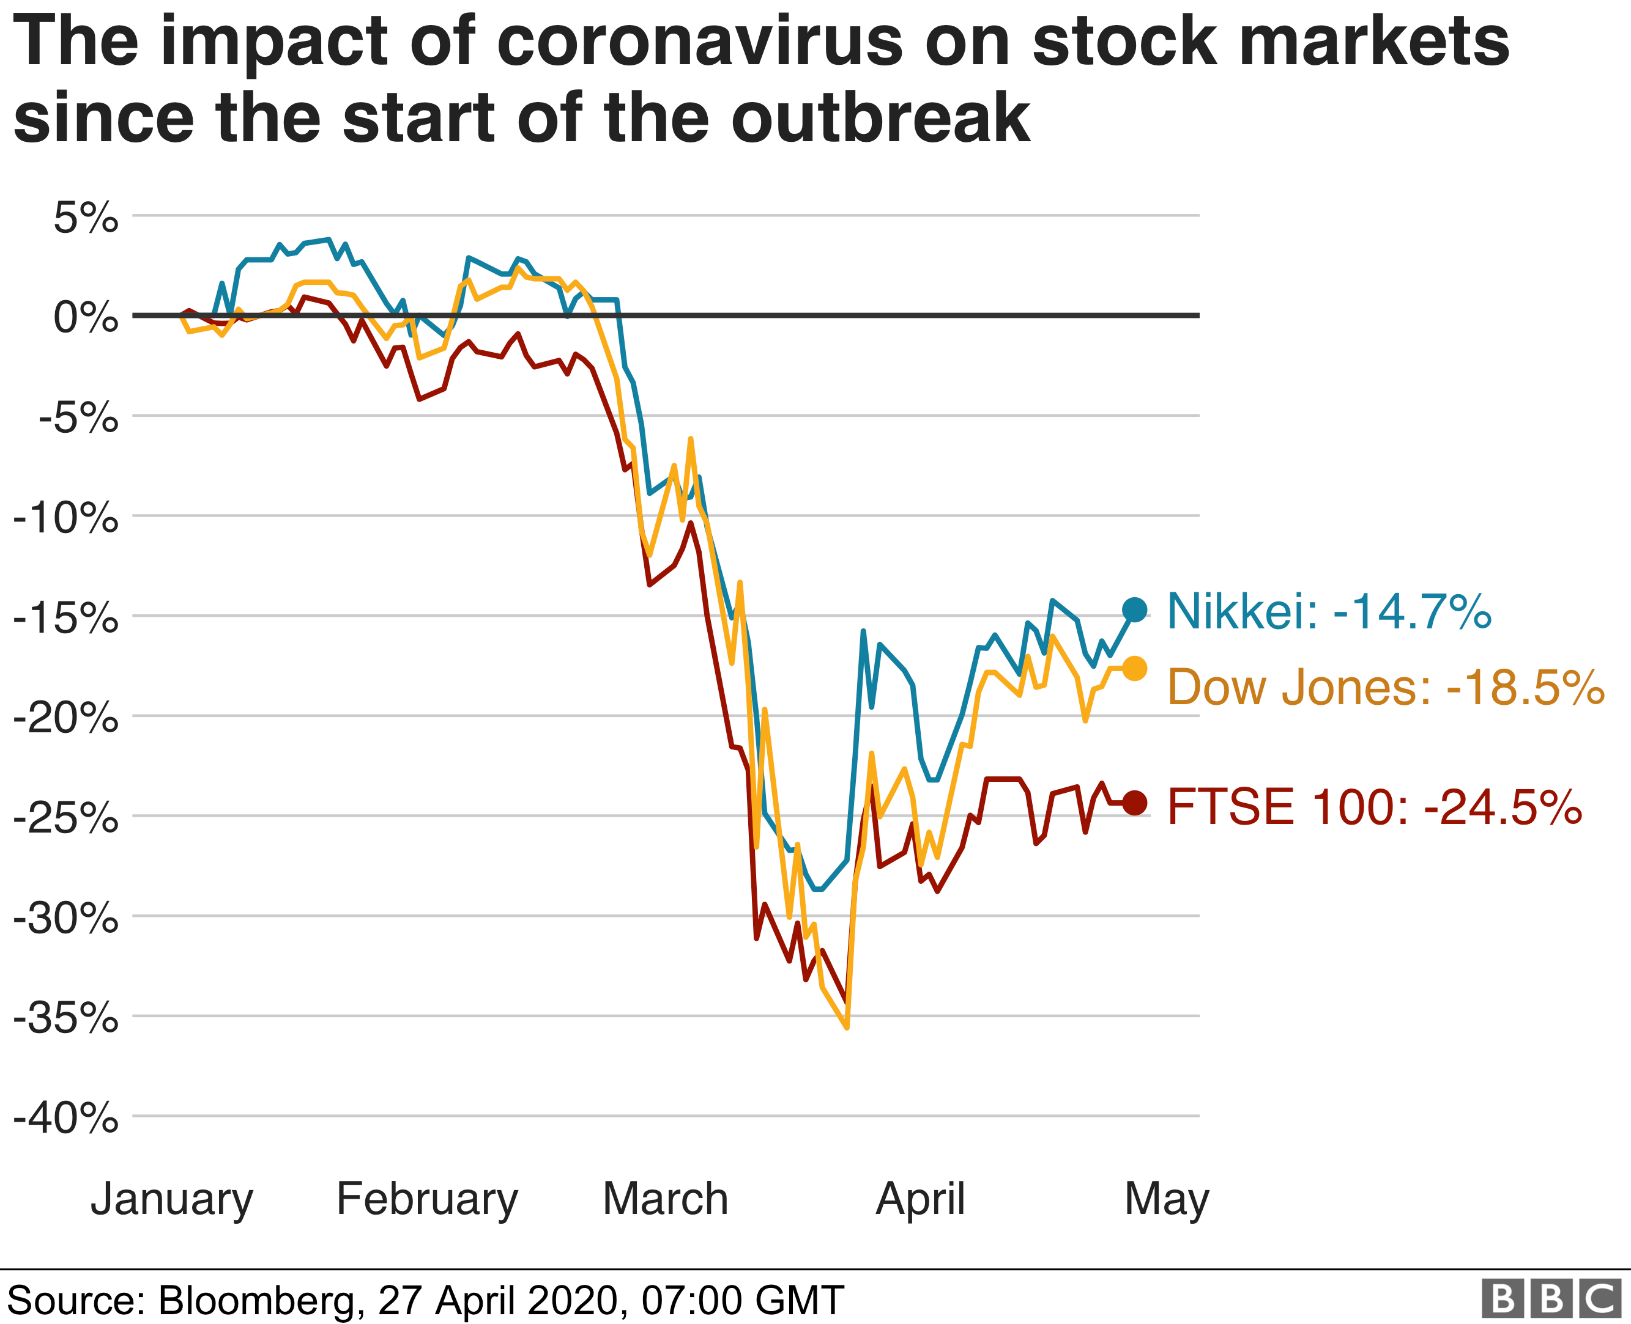

COVID 19 – The great disruptor?
Massive global impacts, socially and economically
Very personal impacts
Micro and Macro level impacts
COVID19 has BROKEN ‘normal’ life.

Slide 4
COIVD19 has also broken outreach, widening participation and evaluation as we knew it
Everyone is affected, staff and students:
  Social distancing
  Lockdown
  Economic uncertainty
  Educational uncertainty
  Health and wellbeing
  Mental health
  New modes of working

Slide 5
Silver linings / positive readings?
COIVID 19 = significant individual suffering and loss
But also….
Possibility of creative destruction:
Schumpeter – Capitalism, Socialism and Democracy - "gale of creative destruction" = "process of industrial mutation that incessantly revolutionizes the economic structure from within, incessantly destroying the old one, incessantly creating a new one".
Reflexivity:
Sociology - Beck and Giddens. Risk society and reflexivity
the way that modern society responds flexibly and dynamically to a changeable present and uncertain future – by adopting a reflexive approach.
Archer – individual reflexivity
mediation between individual agency and external structure – makes social change possible

Slide 6
Breaking things leads to breakthroughs
Things breaking and going wrong
+
A reflexive approach
=
New ways of doing things.
What is important is how we learn from failures and breakings and how we respond to them.

Slide 7
‘Through the eyes of boys’ – A case study based on a project designed to engage white working class boys with Higher Education
Chris Bayes

Slide 8
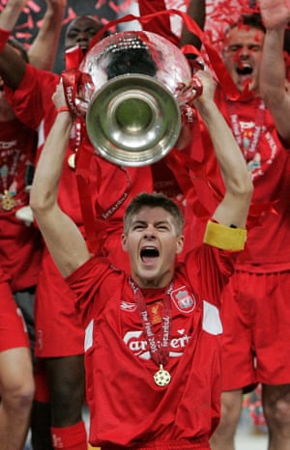
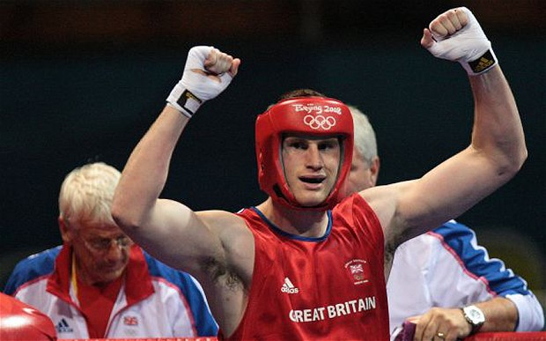

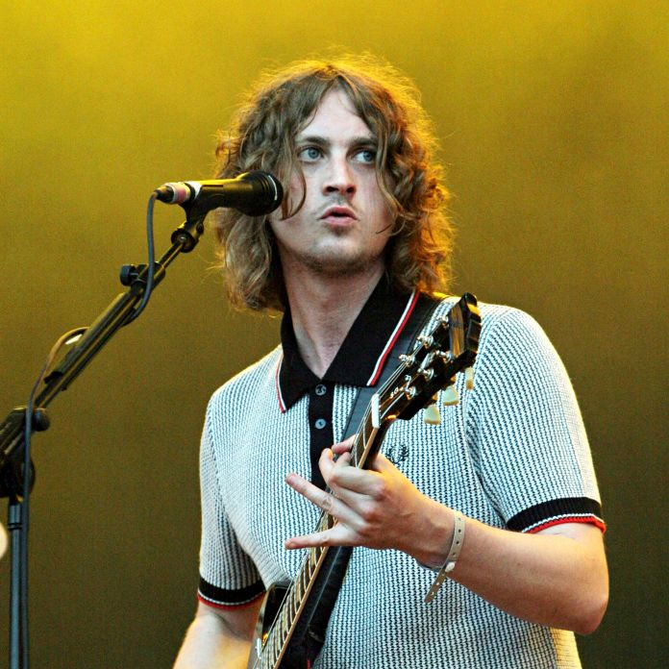
“White working class boys at the end of the day, they’re unsuccessful.” – Three participants in OFFA WP writing course, October 2016.
Notes:
They all are teenage contemporaries of mine, who are all very successful and have never been near a university.

Slide 9
WWCB and HE – An ongoing challenge
In his 2016 study, ‘Bucking the trend’, Raven identified “Concerns over the gender gap in higher education [HE] participation are not new. The ‘low (HE) participation rates of working class boys’ was highlighted as ‘a particular feature of under-representation in higher education’ in an Action on Access study of 2006” (Jones, 2006)
Whilst May’s rhetoric advocated that HEIs should actively target this cohort, the sector did not “have an agreed definition of this group to work with”. (Baars et al, 2016)
The cost of HE is particularly prohibitive for this cohort “for white working class boys, the fear that a university degree is a poor form of investment is a greater barrier than the upfront cost of studying.” (Baars et al, 2016)
Social class in the 21st century is a somewhat divisive and tricky issue to quantify (Savage et al, 2015) – “More Higher Education doesn’t mean more equality.”

Slide 10
‘Through the eyes of boys’
The initial idea and pilot phase

Slide 11
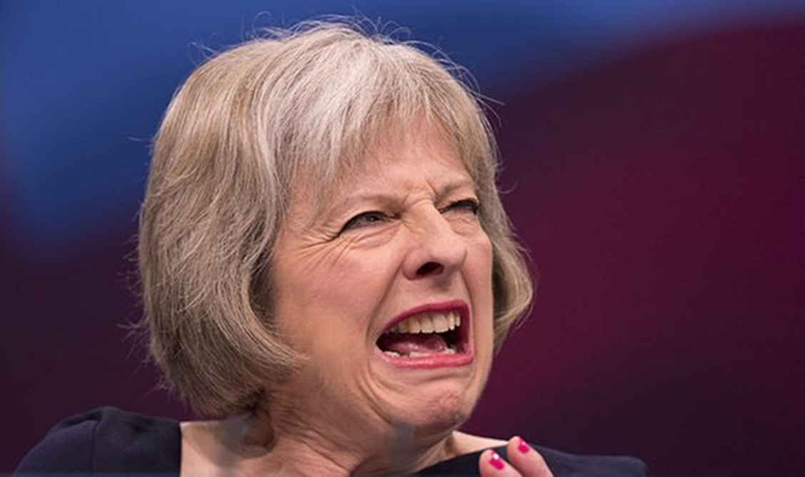
“If you’re a white, working-class boy, you’re less likely than anybody else in Britain to go to university”

Slide 12


The pilot project
Began developing project idea in transition phase between NNCO and NCOP
Targeting, staffing and managing expectations – Issues within participating schools and the project team itself
Pilot phase launched in May 2017 with 67 students from 4 Liverpool schools from different parts of the city - Began at The UoL – invited parents and carers
Followed a fairly traditional ‘aspiration raising’ delivery model
University visits, London residential, supplemented by ‘mentoring’ sessions

Slide 13
Lessons learned
Clear desire for this type of project amongst Senior Leaders within schools – ‘This could be THE silver bullet’
We tried to run before we could walk…☺
Clear that Aimhigher ‘Aspiration raising’ model was no longer fit for purpose – ‘We need a step change in widening participation’ (Les Ebdon)
Successes with initial cohort, could not be fully attributed to participation in project – “low hanging fruit”
In order to be successful, project needed to be co-created and delivered in partnership with relevant stakeholders – Including those outside traditional HE space
Operating within ‘deficit model’ confines – Staffing, Structures, Support (or lack there of)

Slide 14
Through the Eyes of Boys
Success stories
  Connor – After 3 tutoring/study skills sessions, allowed to take Higher Paper in Maths
  Richard – At risk of expulsion and during Governors hearing his involvement and attendance in the project was a deciding factor in him getting a last chance
  Jamie – Used photos he took on London Residential for his GCSE art portfolio and college interview, offered a place
  Ste – London Residential attendee, evaluation: “Going to London has made me feel more confident” – Has been offered a scholarship at Eton Sixth Form with the Hope Opportunity Trust
Notes:
Hanson and her unwitting deficit model dialogue when discussing the project

Slide 15
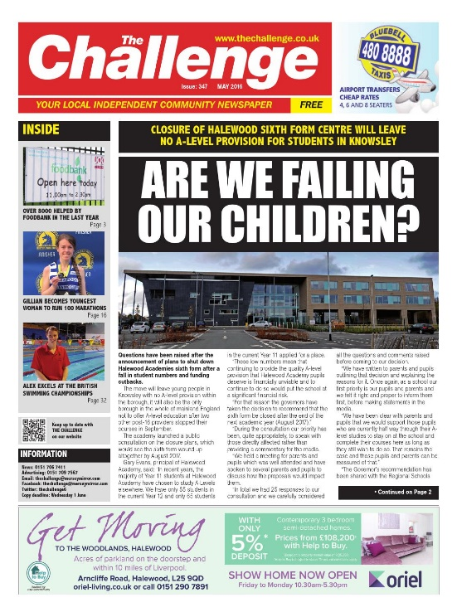
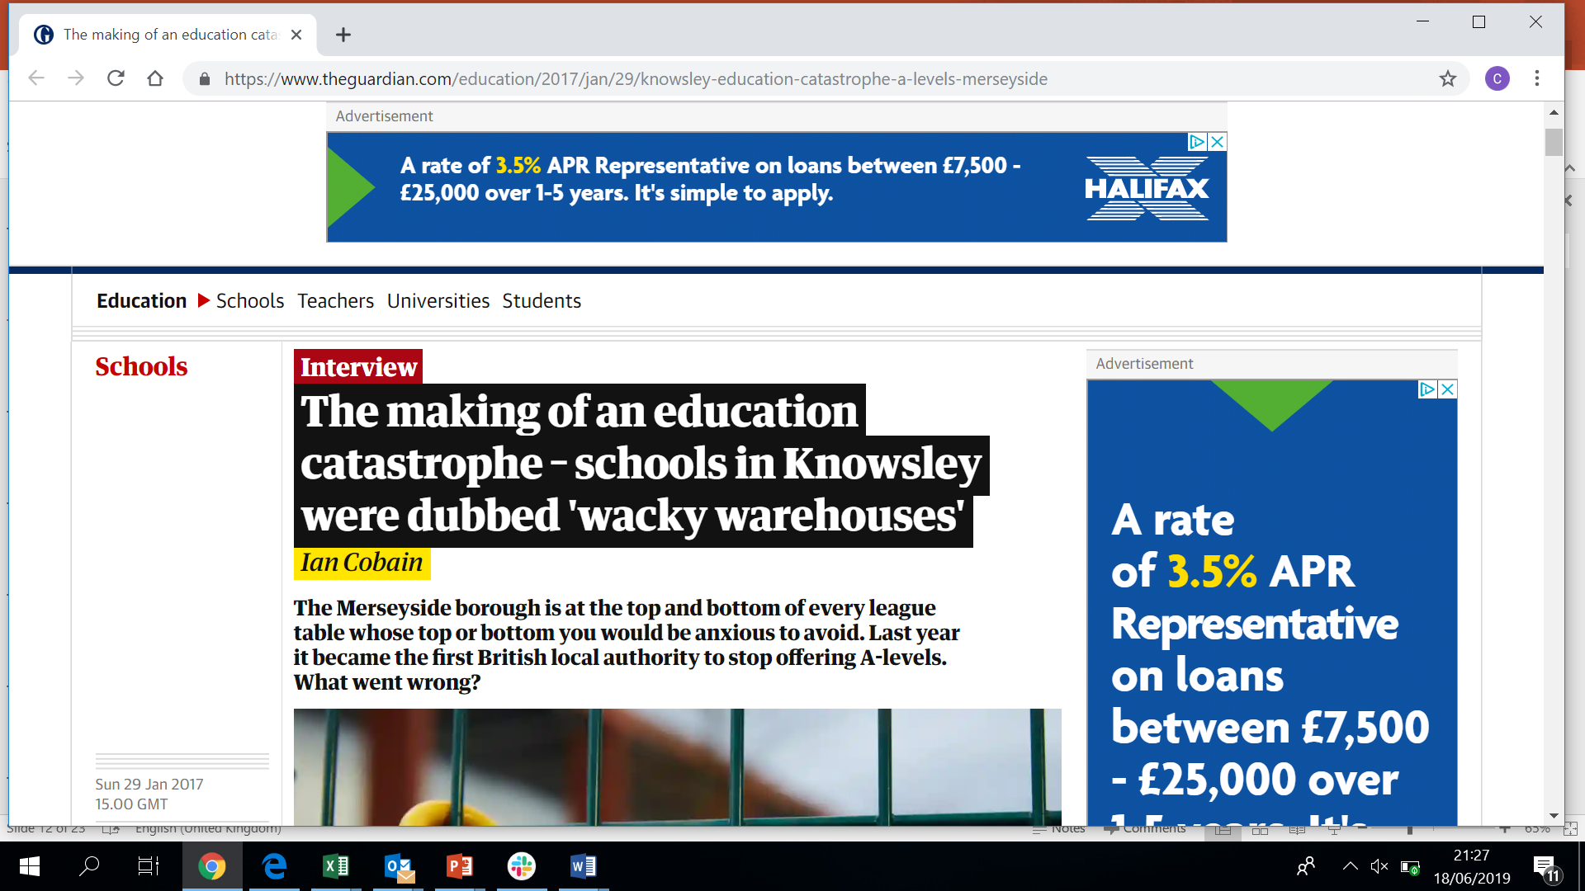
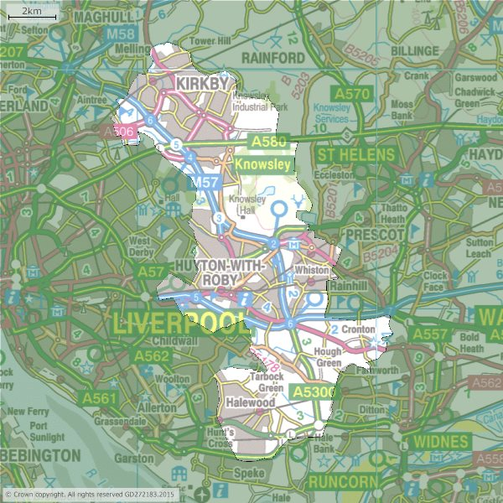
Phase Two – The Knowsley arm
Borough with lowest performing educational attainment in England
Only local authority offering no A level provision
High performing primary schools, but ‘Schools for the future’ programme and creation of ‘wacky warehouses’ led to young people being educated outside of the borough
Geography of the borough is bizarre

Slide 16

Knowsley – Better together
Rare example of a local council acting as a facilitator for multi-agency approach
Representatives from primary, secondary, Further Education and Higher Education engaged in ‘Better together’
At first meeting, subbed in for my ‘boss’ and spoke passionately about my own ‘learning journey’ and lived experience in Knowsley
Director of Children’s Services, several Heads and Policy Officer were all very interested in project, all agreed that a co-production model was the way forward

Slide 17
Phase two – A new approach
Genuine co-production model, Headteacher/SMT buy-in, developed the project with people who knew “the lads” – Head & Deputy Head attended All Saints, Kirkby themselves
Developed a programme which went beyond usual HE “aspiration raising” – Inclusion of local employers and activities which would excite the lads
Took lessons from the pilot and applied them to create something fit for purpose

Slide 18
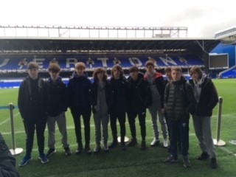
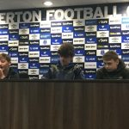
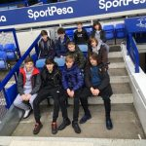
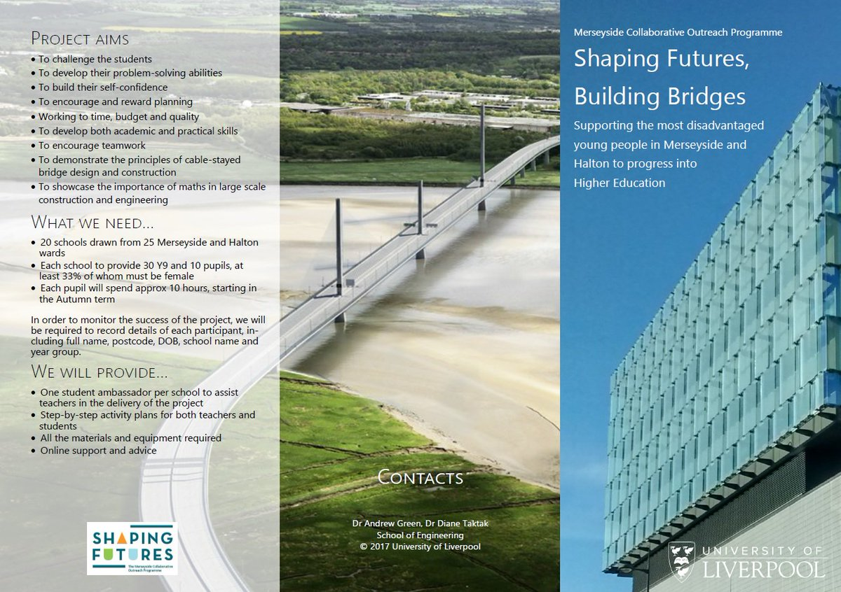
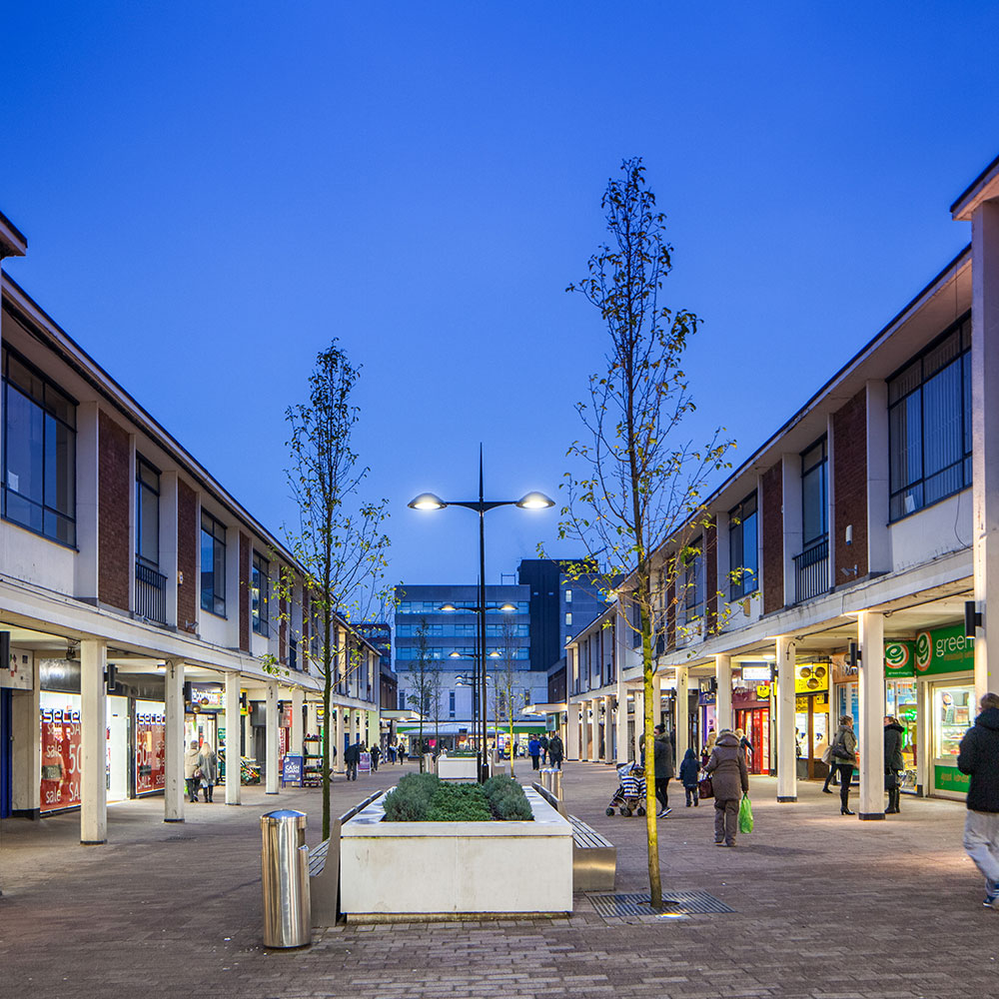

Slide 19
Analysing impact and progression
Schools looked at previous cohorts GCSE results identifying significant underperformance with boys who would have gained grade 4’s in their KS 2 Sats – “Least likely, most able”
Schools reported improvement in attendance, punctuality and engagement in lessons and wider school life.
As part of the project, the lads were given first hand experience of the employment sector in an industry they themselves had expressed an interest in.
During university visits which bookended the project (Liverpool and Keele), the lads were unrecognisable from start to finish. Improved confidence, maturity and communication skills.

Slide 20



Analysing impact and progression
5 participants taking up apprenticeships with M.J Quinn – Telecommunications, mechanical and electrical engineering, fire detection and air cooling.
A further 10 participants have taken up apprenticeships with Walton Flooring – Floor fitting, sales, admin and customer services
The remainder (25) have gone onto FE, either at Sixth Form centre at Winstanley (partnership developed via ‘Better Together’ or local FECs – How many will progress onto HE?
Good outcomes for the lads, but is it what the funders expect? Is what the funders expect realistic?

Slide 21
Outcomes and reflections
Both projects helped a cohort of lads with their future progression, phase two more so, but even then impact was limited by circumstances
Helped develop stronger links between two local schools serving the same community
All Saints & Kirkby High now rolling out the projects from Y7 upwards, without full buy-in from Shaping Futures
‘Better together’ sadly came and went. A positive force for change replaced by someone, who apparently “understands the system” more…

Slide 22
Recommendations
Multi-agency approach is crucial to solving long standing issues around social deprivation
Universities play a part in this, but too often feel they can solve these problems operating in isolation from each other and other sectors
Understanding regional wants, needs and enthusiasms are integral to project success
Role models are important, but we need to move beyond the tired promotion of ‘learning journeys’ via Student Ambassadors
Teachers involved in this project understood the kids, the next step would be co-create something with young people – Reclaim, Youth Focus NW

Slide 23
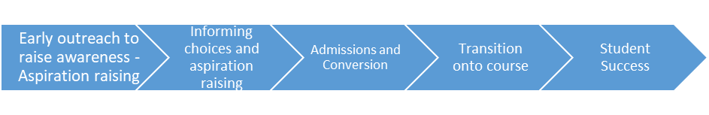
Developing a pathway for progression
Year 7 – Year 9 – Thinking wider
‘Through the eyes of boys’ –
Shaping Futures – Y9 – Y11
Input into ‘Scholars’, ‘Dream, Plan, Achieve’ – Compact schemes
Student Ambassador work – Becoming role models
Bayes, C. (2019) “Blurred Boundaries – Encouraging greater dialogue between Student Recruitment and Widening Participation

Slide 24

A Heroic Failure? Learning from False Starts in a Maths GCSE Intervention
Dr Julian Crockford
Villiers Park
@JulianCrockford
@JulianCrockford
@WPREU_Sheffield

Slide 25

Universities and Attainment Raising
“We expect all institutions to set out in their 2018-19 access agreements how they will work with schools and colleges to raise attainment for those from disadvantaged and underrepresented groups. This includes a strong expectation that we will see greater numbers of higher education providers sponsoring schools (either as main sponsor or co-sponsor) or with advanced plans to do so, with a view to improving attainment of disadvantaged and under-represented groups to enable them to apply to higher education if they wish to.”
OFFA (2017) - Strategic guidance: developing your 2018-19 access agreement

Slide 26

Challenges
Attainment is a highly complex area:
  “This is a complex topic which spans the remit of government departments and public services. As such, one of the underlying themes of the report is that cross governmental action will be needed to address the social problems causing attainment deficits – they are not purely an educational issue.”
  DfE (2018) Understanding KS4 attainment and progress: evidence from LSYPE2 - Research report
SO
We should narrow the focus
To key qualifications Maths and English GCSE
To key curriculum issues in Maths GCSE

Slide 27

But also….
Other issues with HE attainment raising:
  Teachers work with their students over a long period in a concentrated way
  HE outreach tends to dip in for a short period
So what kind of claim to causal change can an outreach approach make?
And
  Schools are often poorly resourced / under pressure
  Teachers often have to balance needs of individual students against a whole large class
Would HEIs claiming impact be disrespectful to over-stretched and over-worked teachers?

Slide 28

Threshold Concepts
Meyer and Land (2003) – Threshold concepts in economics
  Difficult conceptual blocks
  Transformation of understanding when blocks are overcome
“Threshold concepts have been described as portals, opening up a new and previously inaccessible view of a topic, a view without which students would be unable to fully progress intellectually.”
Breen and O’Shea (2016)

Slide 29

So, we thought. What if we:
Train HE outreach mentors
  To work with individual students
  To address specific threshold concepts in the GCSE Maths curriculum
  And thereby provide additional capacity to teachers
  And deliver what teachers tell us their students need – by way of supporting individual students to cross conceptual thresholds - but which they don’t have the available time or resources to deliver

Slide 30
We were also chuffed with our evaluation plan
Evaluate acquisition of specific curriculum knowledge using a test (supporting robust measures)
Use before and after tests to assess increase in knowledge acquisition (change across time)
Give same tests to a counter-factual non-participant group (impact of the intervention)
Produce strong empirical outcomes (OfS evidence type 2) and a causal inference (OfS evidence type 3)

Slide 31

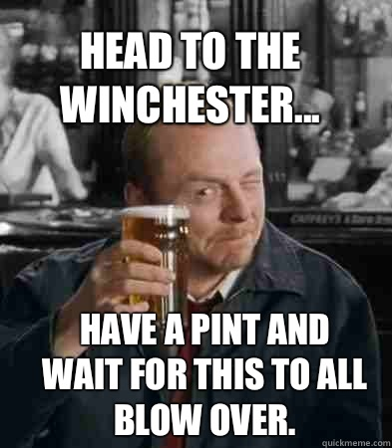
Implementation Plan
Recruit participant schools
Adopt an online mentoring platform
Form teacher advisory group to identify relevant threshold concepts that we could target
Develop targeted evaluation test for these curriculum concepts
Recruit mentors (studying for Maths related degree subject)
Recruit participants
Get agreement for accessing a counter-factual group
Deliver pre-test
Roll out mentoring programme
Deliver post-test
Bob’s your uncle

Slide 32

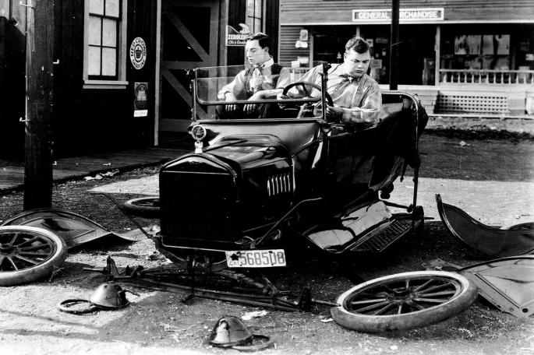
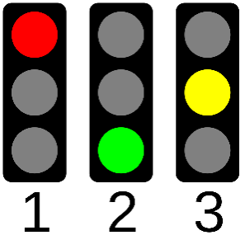

And then the wheels started to fall off…..
Recruit 3 participating schools
Adopt an online mentoring platform
Recruit teacher advisory group
  Only 2 teachers were able to attend
  Had to work through Year Heads instead
4. Develop targeted evaluation test
  Schools couldn’t agree which areas of the curriculum to focus on (different curriculum schedules)
  We were only resourced to write one set of tests
  So all schools had to work to the same threshold concept – not necessarily relevant to their students

Slide 33

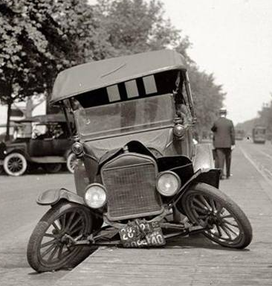
5. Recruit mentors (Maths degree)
6. Recruit participants
Get agreement for testing counter-factual group
  Difficult to get school agreement / student groups to volunteer
  Difficult to schedule pre-test for non-participation group
Deliver pre-test
  Didn’t get full engagement from all participants
  Participants couldn’t see the need for / didn’t want to take an ‘extra’ test
Roll out mentoring programme
  Poor student engagement / few sign ups
  Missed appointments
  Limited access to IT / IT problems
10. Deliver post-test
  See above
  Evaluation tests - pulled

Slide 34
Participant /Teacher / Mentor Feedback
The online mentoring platform was highly regarded
BUT
Need for parents to sign up their offspring reduced take up
Timing of sessions was an issue – participants did not want to stay after school to access the platform
Restricted curriculum focus = limited interest for participants and teachers
Other study priorities took over
Participants forgot to book or show up (online) for the mentoring sessions

Slide 35
What we’ve learned
The basic principles of the project might still be sound
Implementation and evaluation processes ultimately grounded by practical issues
School resources are stretched and school teams weren’t able to scaffold and manage their participants
Participant self-management didn’t work (apart from 1 very keen pupil!)
Participants weren’t always in a position to judge the threshold concepts they struggle with without a teacher’s advice
We weren’t able to deliver flexible provision targeted at specific threshold concepts because of scale and project resourcing
Both schools and participants need more scaffolding and support (more resource at the project level)

Slide 36
So next time….
We will be more mindful of the many challenges of working with school partners
Schools are often totally under-resourced, under pressure, juggling multiple agendas and priorities
Different schools tackle different parts of the curriculum at different times
We will better scaffold the experience for participants
To ensure that participants understood the process / how it was supposed to work and were aware of the commitment they needed to make
We will make sure we have enough input and resourcing from the start
We needed detailed engagement from teachers from the start
We needed project manage to a greater degree to ensure all stakeholders remained engaged

Slide 37
References
Breen, S. and O’Shea, A. (2016) Threshold Concepts and Undergraduate Mathematics Teaching, PRIMUS, 26:9, 837-847
Meyer, J.H.F. and R. Land. 2003. Threshold concepts and troublesome
knowledge 1 - linkages to ways of thinking and practising. In C. Rust
(Ed.), Improving Student Learning - Ten Years On (pp. 412–424).
Oxford, UK: OCSLD

Slide 38
Learning from failure and the importance of reflexive practice
Gino Graziano
Director of Widening Participation and Social Mobility
18 May 2020

Slide 39
Failure is good!
…if you learn from it
Some observations
Sector traditionally doesn’t acknowledge its failures
Evaluation came late
Practice v research
Why Evaluate?
Excitement in testing yourself and projects
Insight comes from discomfort

Slide 40
Case study: working class boys project (1)
2009-2011
Project to work with Y9 working class boys in local schools
  Framework designed by Aimhigher, led a franchise
  Sequential sessions and trips leading up to a presentation
  Disaffected with education
  Aim to challenge, motivate and reengage
Problems throughout
  Aware of disconnect early on
  Continuing (and declining) lack of engagement
  Presentation no show
  Fail!

Slide 41
Case study: working class boys project (2)
“Period of introspection”
  Who is to blame?
  Carry on or drop it?
Reflect
Research
Recalibrate
Reboot

Slide 42
Case study: working class boys project (3)
Change emphasis for next cohort
  Put myself into the framework
  Embedded agency and responsibility
Vastly improved results
  90+% attendance in sessions and trips
  Full compliment at final presentation
Evaluation
  Still not developed past happy sheets
  No tracking
  Programme closed in the aftermath of Aimhigher

Slide 43
The ongoing lesson: agency is effective (1)
Critique of “missionary” approach
“The conversion of those who do not belong to the true Faith is the greatest act of charity that can possibly be performed […] We have something of the utmost value to give to others, something of which they stand in great need, even though they do not know it”
Rev. Johnston, missionary (Girola, 2003)
“You’ve got to get out there and find people, win them over, get them to raise aspirations and get them to think that they can get all the way to the top.”
David Cameron, (Former) Prime Minister (2013)

Slide 44
The ongoing lesson: agency is effective (2)
OFFA / SHU project
Policy discussion
“What might look like ‘low aspirations’ may often be high aspirations that have been eroded by negative experience” (JRF, 2013)
“Children from disadvantaged backgrounds…have high ambitions…But the odds against achieving them can worsen with age. All too often there comes a point at which expectations shrink” (Education Committee, 2014)
Theoretical discussion
“…deficits are informed by tacit models of professional understandings, which invoke ‘standards’ which in turn come to presume deficits against which people are judged, and their identities constructed” (Candlin, C. and Crichton, J., 2010)
“Within the education system all authority remains vested in the middle classes…the system itself is one which valorizes middle rather than working class cultural capital” (Reay, 2001)

Slide 45
The ongoing lesson: agency is effective (3)
Access Your Future
SLN funded co-research project
Recurring themes:
  Pressure
  Cynicism about the education system
  Finance
  The ‘real world’ v university
Further lesson…we can learn a lot from our audience

Slide 46
Insights
The missionary model is not effective
A lot of WP is based on assumptions
We are not here to save people – if we are honest, we need to learn from them and we need their help
We need to include our audience in ALL stages of our work
  Research, design, delivery and evaluation
Agents, not subjects
Respect people’s culture and background

Slide 47
Final thought…
“Most books are written for the middle class, and generally they only have two modes of talking about the working class. The first is a kind of lofty contempt at the vulgarity, the stupidity of those people. The second is a kind of patronizing concern, which paints the working class as nothing but victims. Of course, working people and poor people don’t see themselves like that. Everybody is the hero in their own narrative.”
Alan Moore, 2016

Slide 48
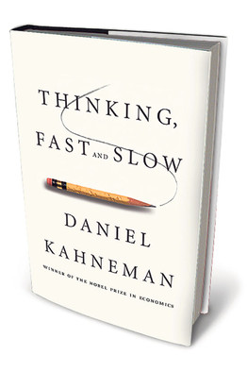
Learning from breakings and failures
We can’t constantly rethink the same things, so we reduce the cognitive load by relying on
Schemas
Heuristics or rules of thumb
Disruptors break these by changing the context.
Increased reflexivity, the ability to reflect, learn and do something different offers us a (new) way out.
We may need to completely rethink how we approach what we do whether this is outreach delivery or evaluation….
The current situation might give us opportunity to reflect on and rethink everything(?). This could be transformative going forward if we take this chance.
Intervention Evaluation

Slide 49
Questions? Comments? Discussion?

